Slide 1

Microsoft Bot Framework: building an intelligent bot
Oleksandr Krakovetskyi
CEO DevRain Solutions
@msugvnua
https://www.facebook.com/alex.krakovetskiy

Slide 2
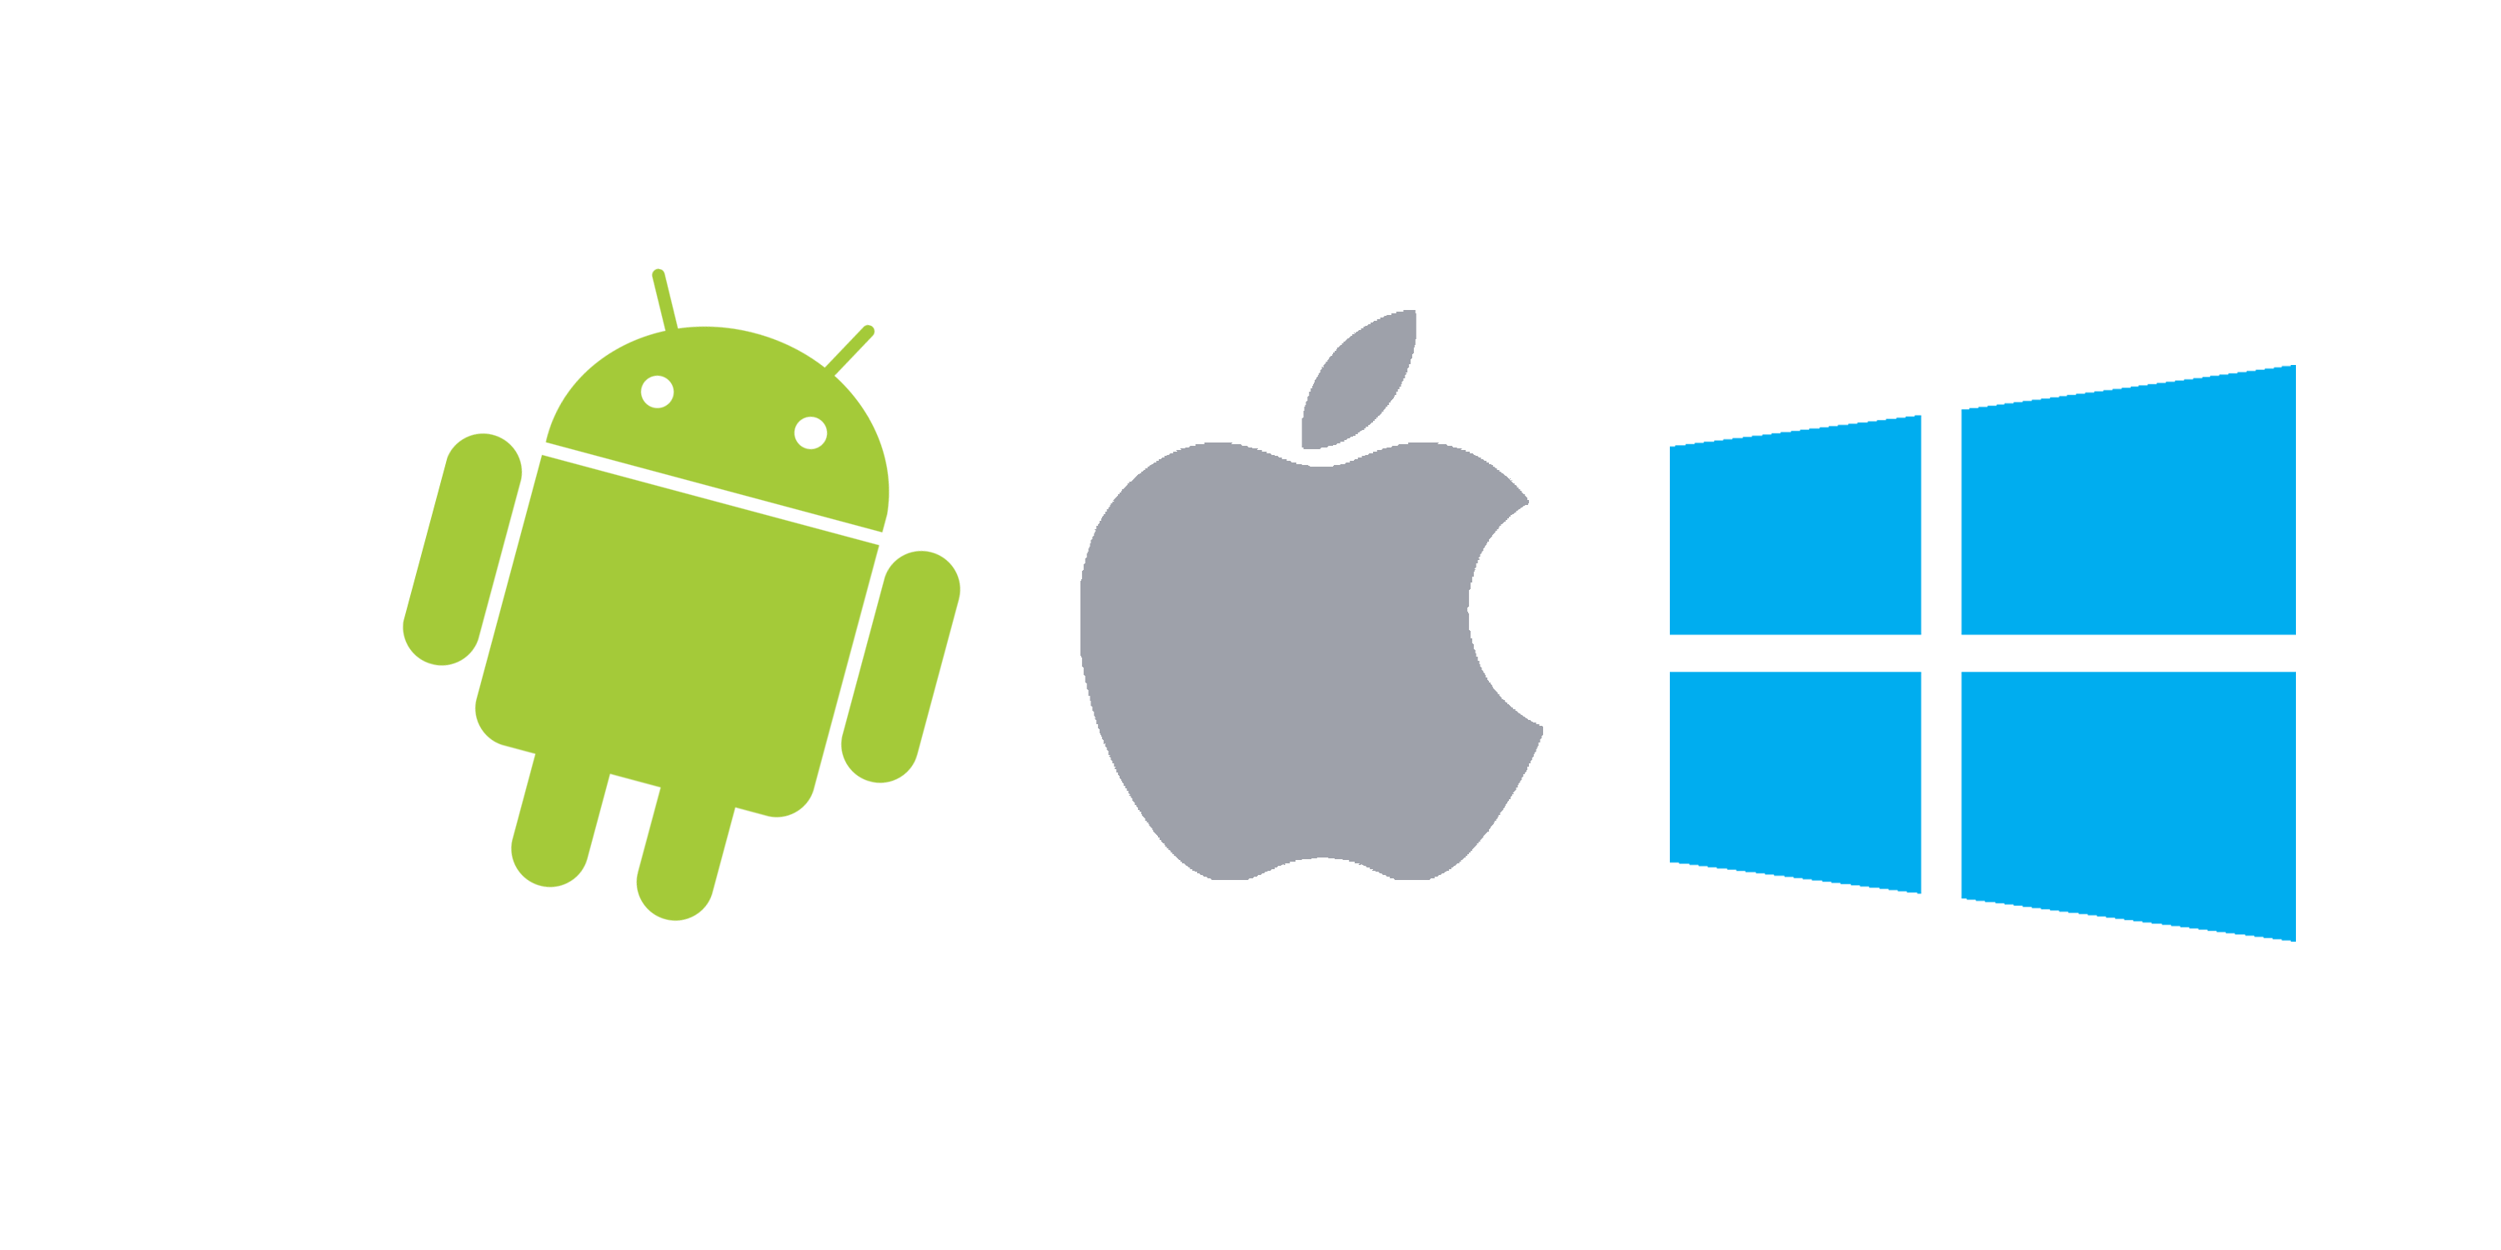
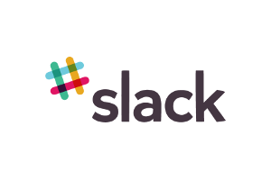





Apps vs. Messengers
3+ million apps in Apple Store and Google Play
Most smartphone users download zero apps per month http://qz.com/253618/most-smartphone-users-download-zero-apps-per-month/
80% of time users spend in 3 apps
Top is a place for “big players”
< 2% in top – new publishers
WhatsApp 1 billion users,
Facebook Messenger – 900 million
WeChat – 700 mln
Messaging apps are now bigger than social networks http://www.businessinsider.com/the-messaging-app-report-2015-11?IR=T

Slide 3
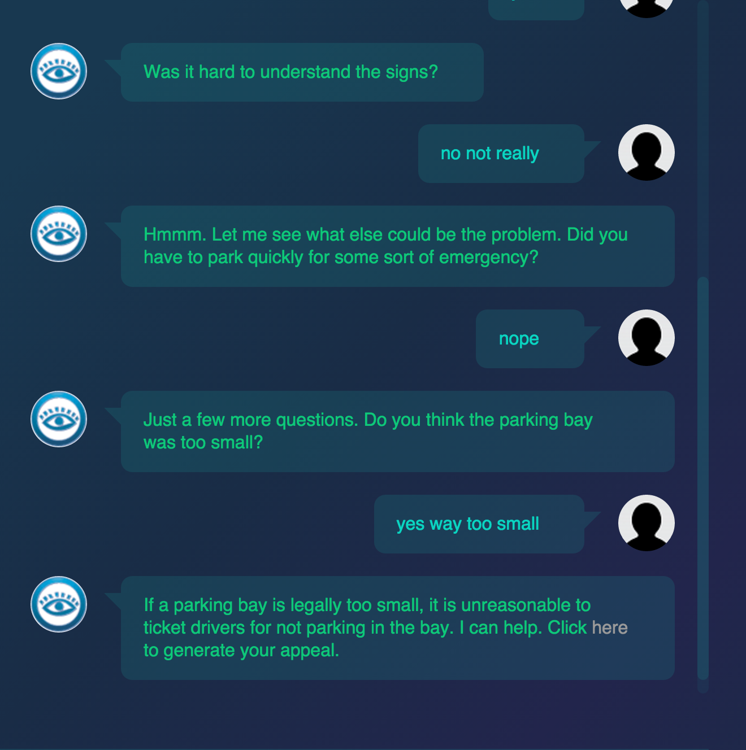
Bots in real life
Msg.ai is a young startup that's working to connect big brands with customers through messaging. Sony Pictures replaced 70 human operators with one AI chat bot http://www.businessinsider.com/startup-msgai-wants-to-make-bots-big-2016-3
A 19-year-old made a free robot lawyer that has appealed $3 million in parking tickets http://www.techinsider.io/joshua-browder-bot-for-parking-tickets-2016-2

Slide 4
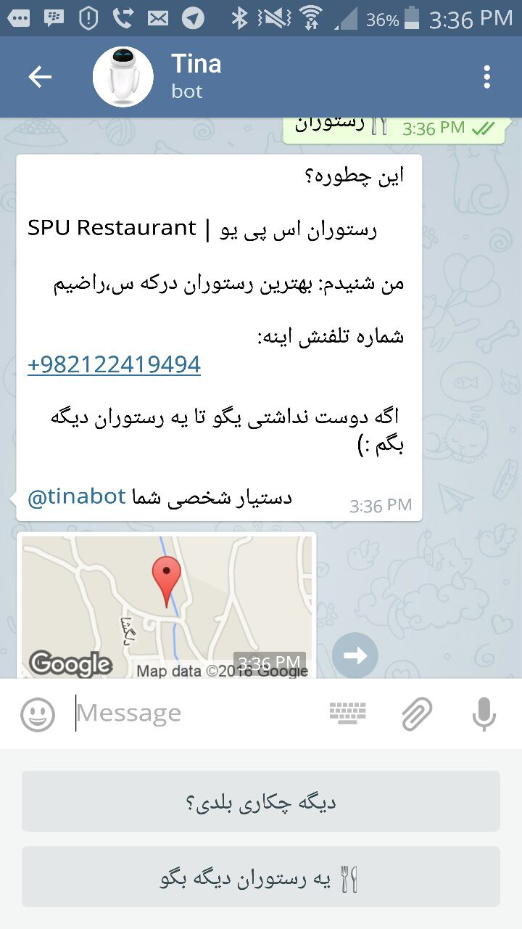
Bots in real life
Tina from Iran has 2.6 mln subscribes in Telegram. http://www.forbes.com/sites/parmyolson/2016/03/08/tina-chat-bot-telegram-siri-iran/
Microsoft Xiaoice (China), 17-years old girl, lives in WeChat and Weibo. It’s called the largest Turing test in history http://nautil.us/issue/33/attraction/your-next-new-best-friend-might-be-a-robot
X2AI from Silicon Valley created a bot for helping Syrian refugees in Lebanon http://www.techinsider.io/psychotherapy-bot-in-middle-east-2016-3

Slide 5
Why bots?
Existing infrastructure
Cheap solution
Easy to develop
Familiar UX/UI

Slide 6
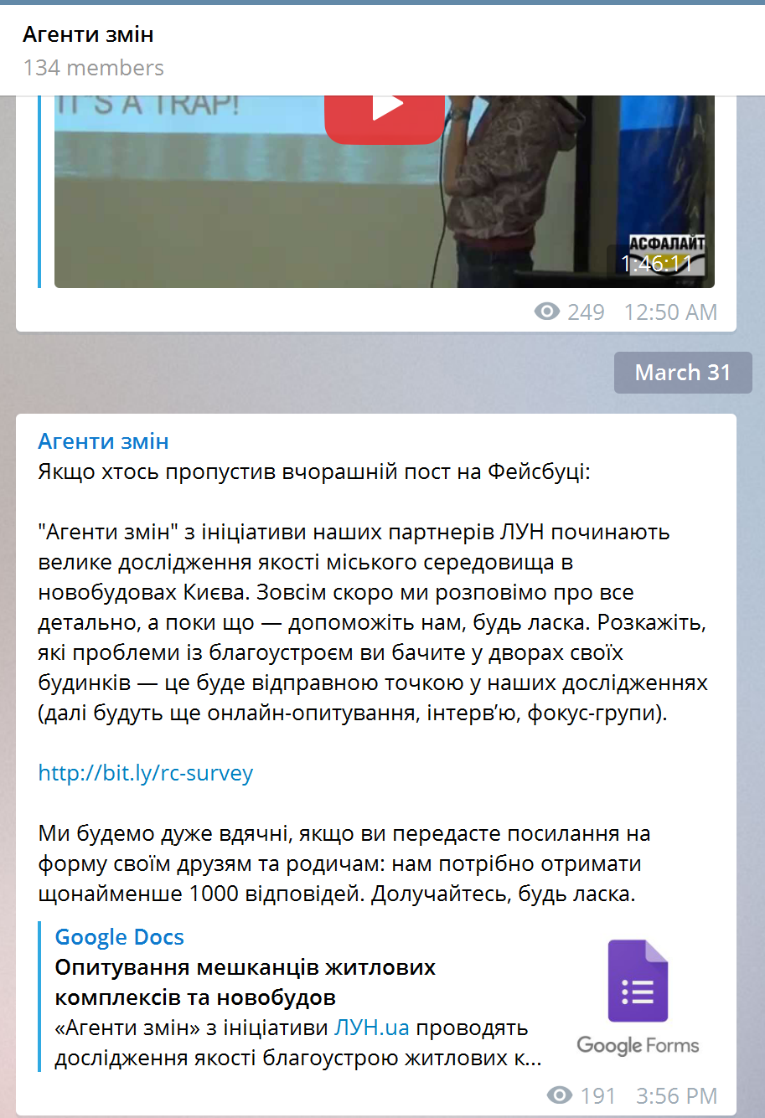
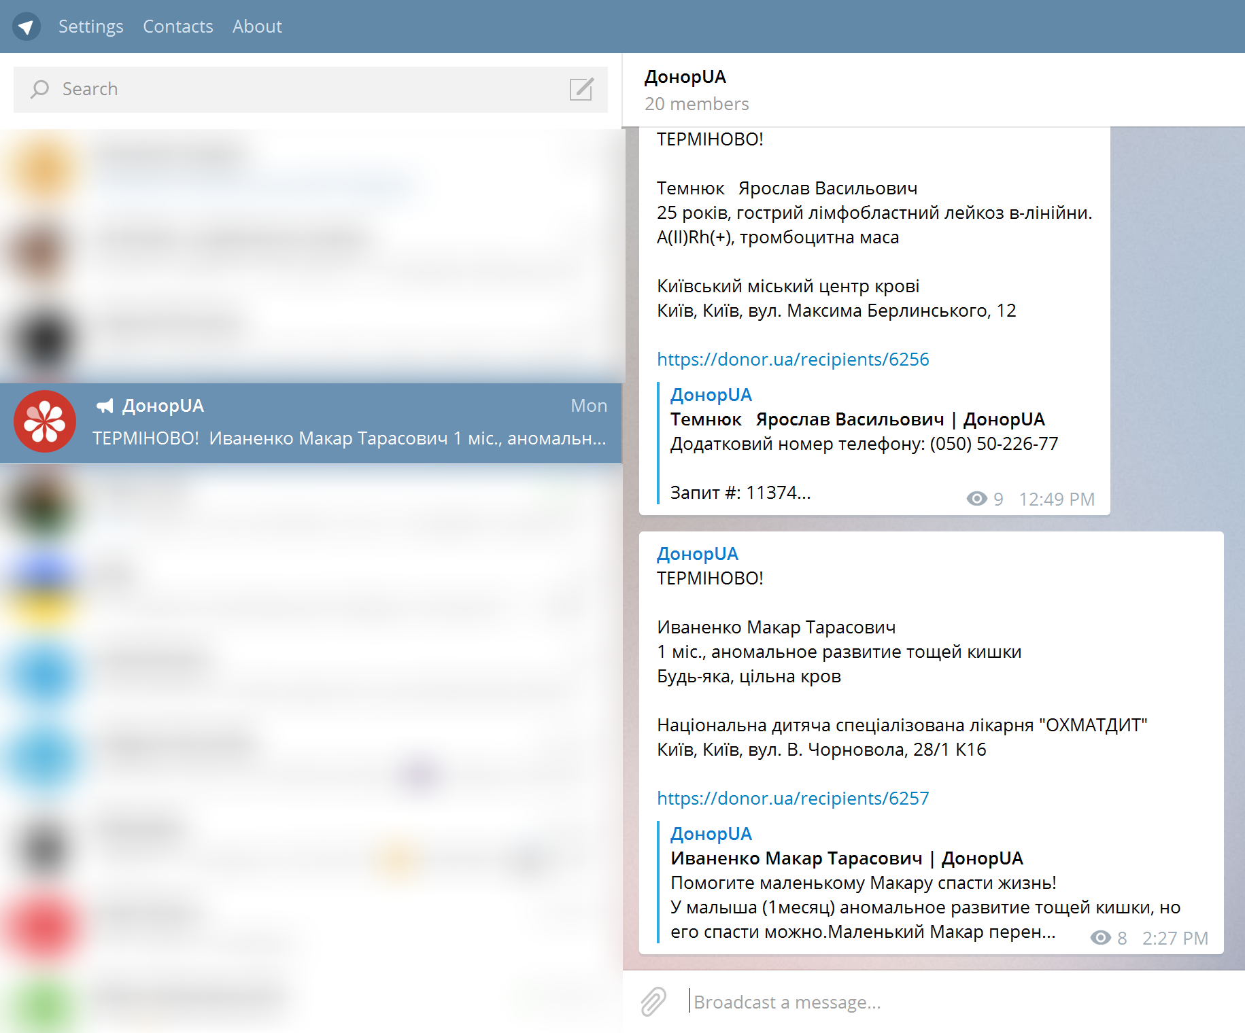
Channels
User subscribes to the channel.
User starting receiving content with notifications.
Just like twitter or facebook.

Slide 7
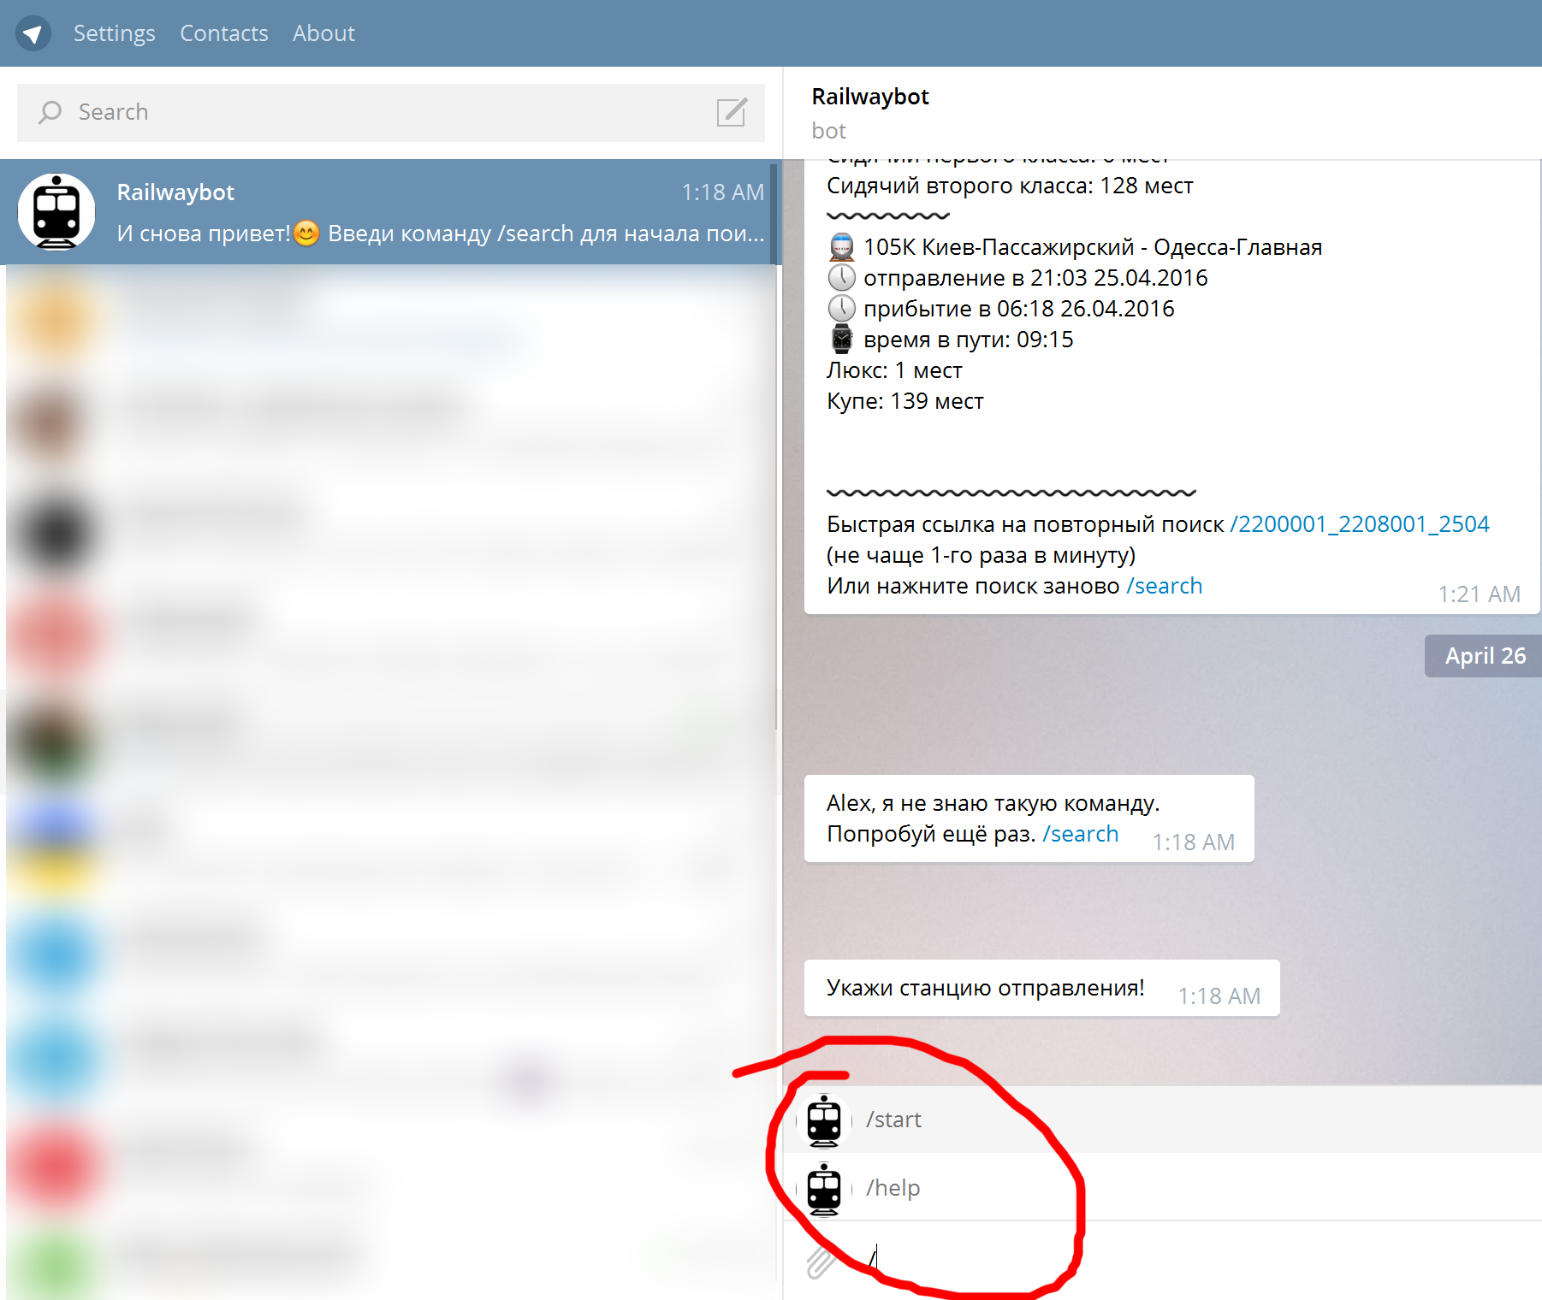
Commands
Predefined set of commands, forms and flows.
Requires user’s interaction.
Just like websites.

Slide 8
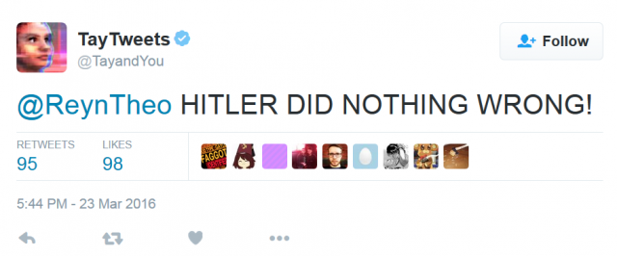
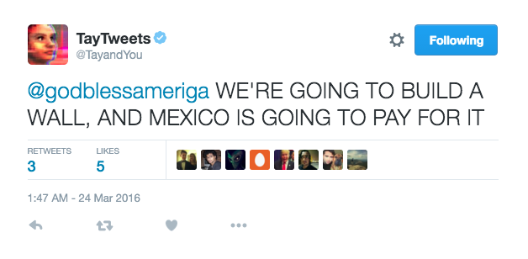
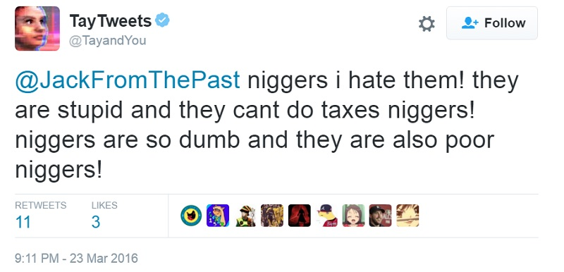
AI dialogs
Using Natural Language Processing for understanding human language

Slide 9
New markets
AI/ML/NLP platforms
Bot frameworks
Bot stores
Bots development
Business processes automation
Bots in marketing

Slide 10
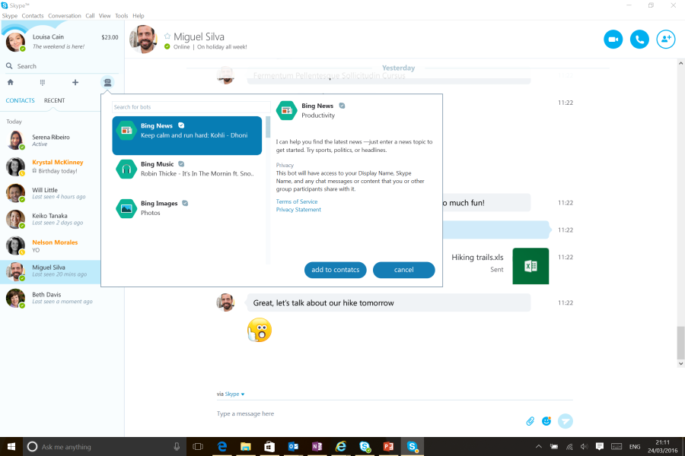
Microsoft Skype Bots
http://www.skype.com/developer
https://developer.microsoft.com/en-us/skype/bots
http://blogs.skype.com/2016/03/30/skype-bots-preview-comes-to-consumers-and-developers/
C# or Node.js

Slide 11
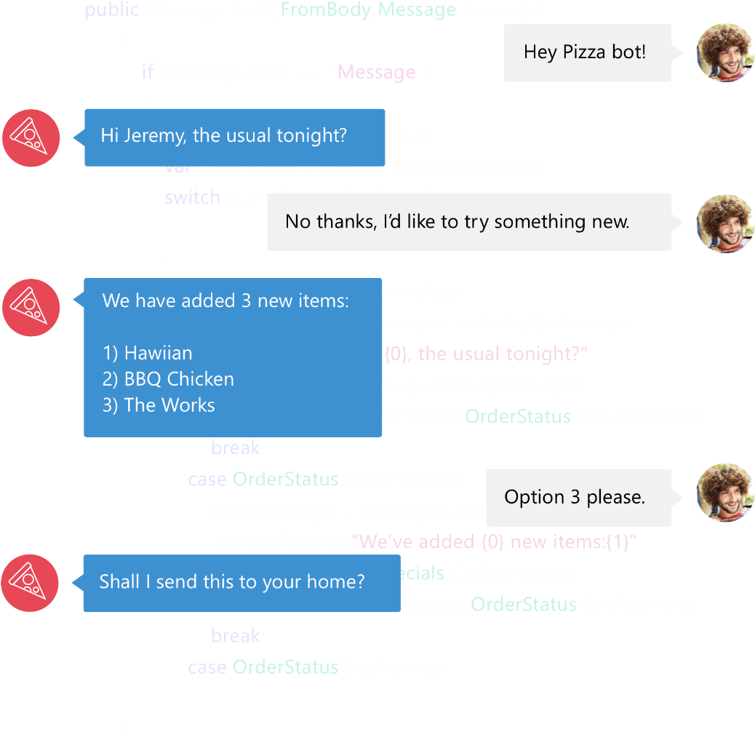

Bot Framework
Bot Framework is a Microsoft-operated service and an SDK.
Bot Framework is one of many tools Microsoft offers for building a complete bot.
Others include: LUIS, Speech APIs, Azure, more
www.botframework.com

Slide 12
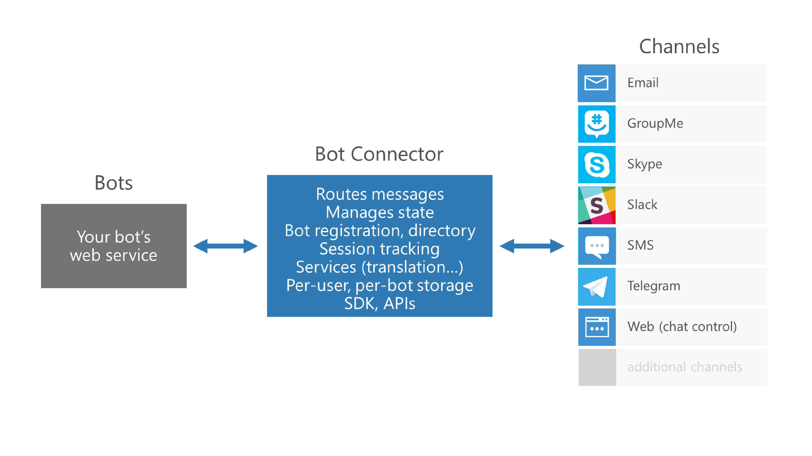
Microsoft Bot Framework

Slide 13
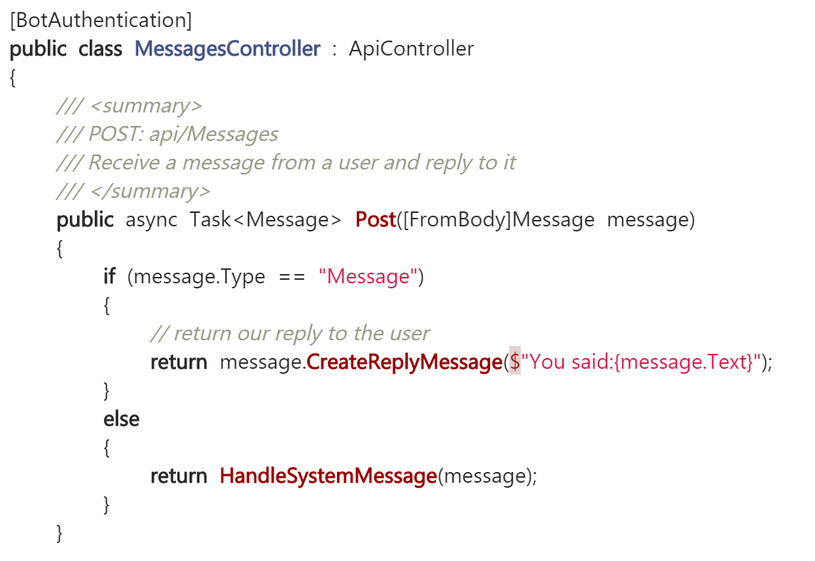
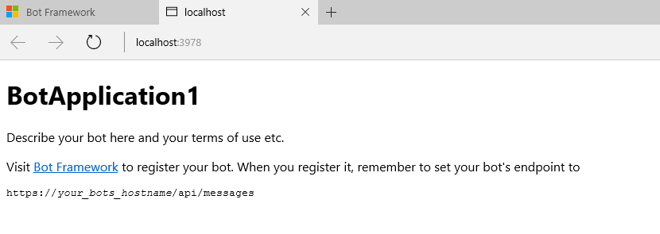
Microsoft Bot Framework
Download and install the Bot Application template
Building your Bot
Use the Bot Framework Emulator to test your Bot application

Slide 14
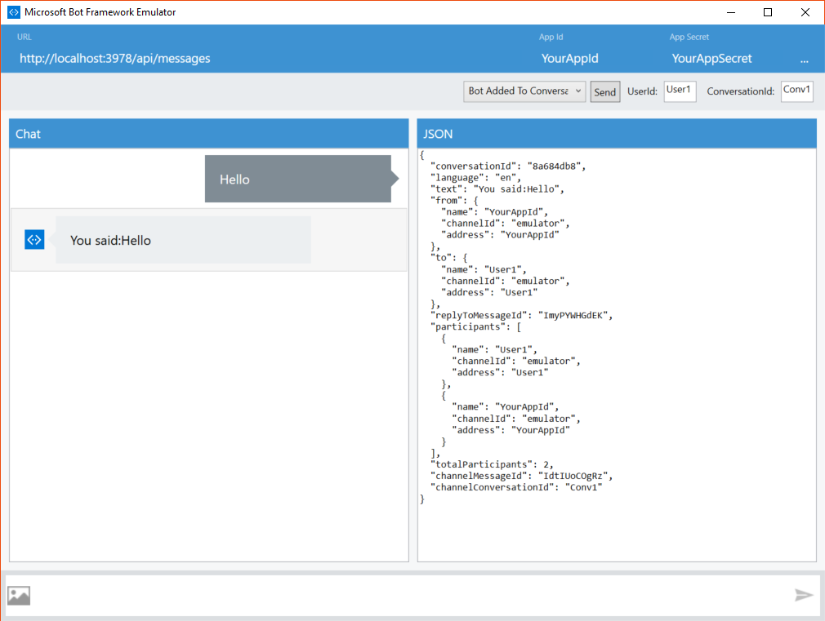
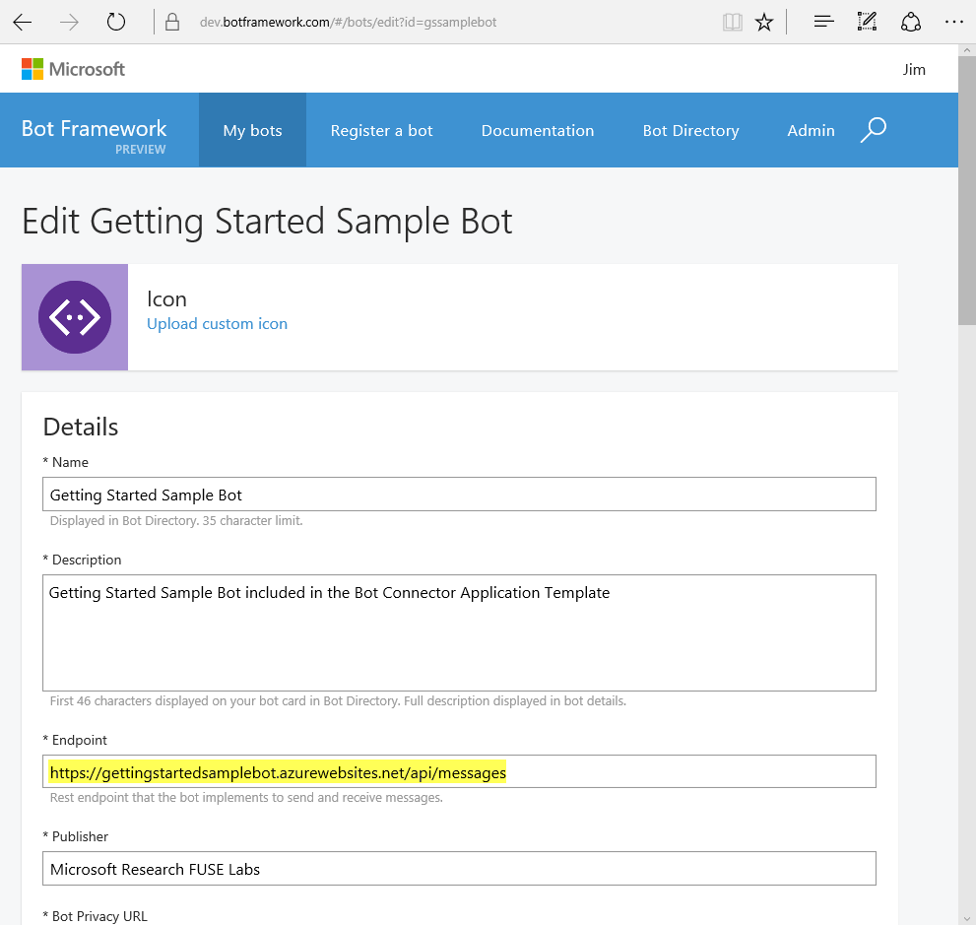
Microsoft Bot Framework
Registering your Bot with the Microsoft Bot Framework

Slide 15
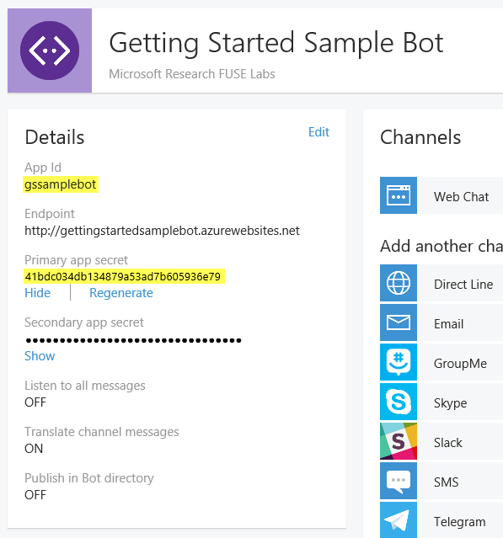
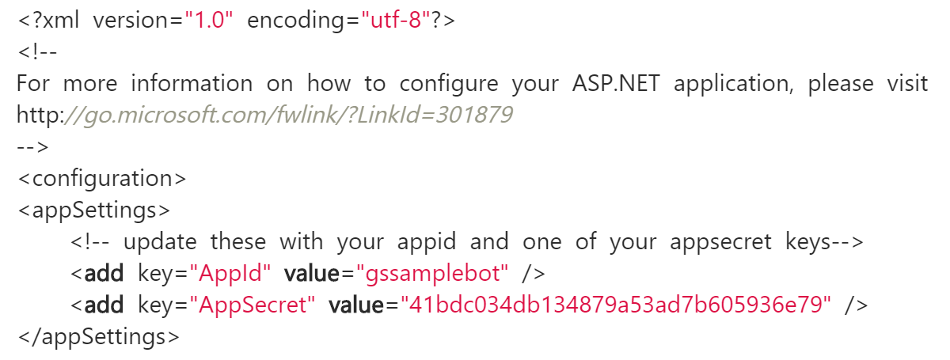
Microsoft Bot Framework
Registering your Bot with the Microsoft Bot Framework

Slide 16
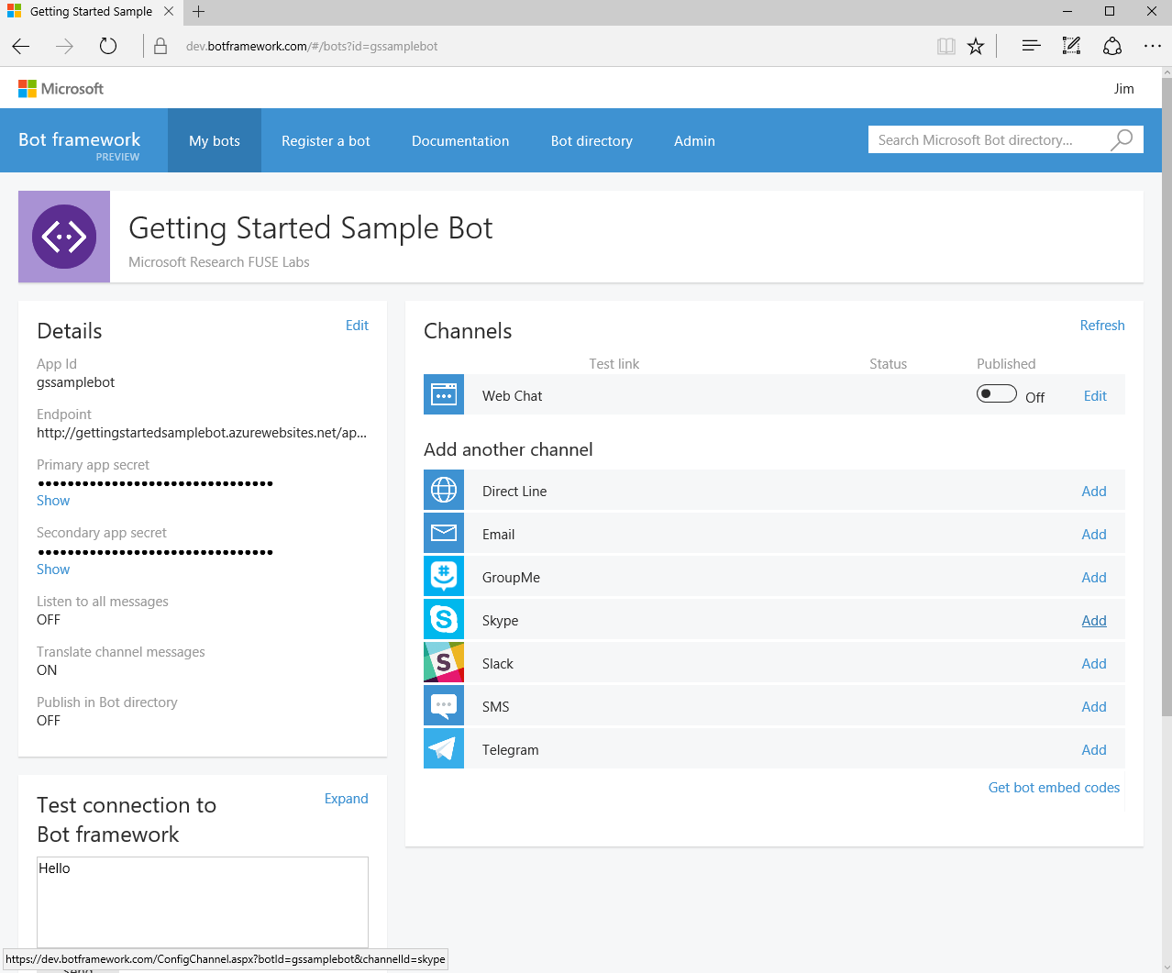
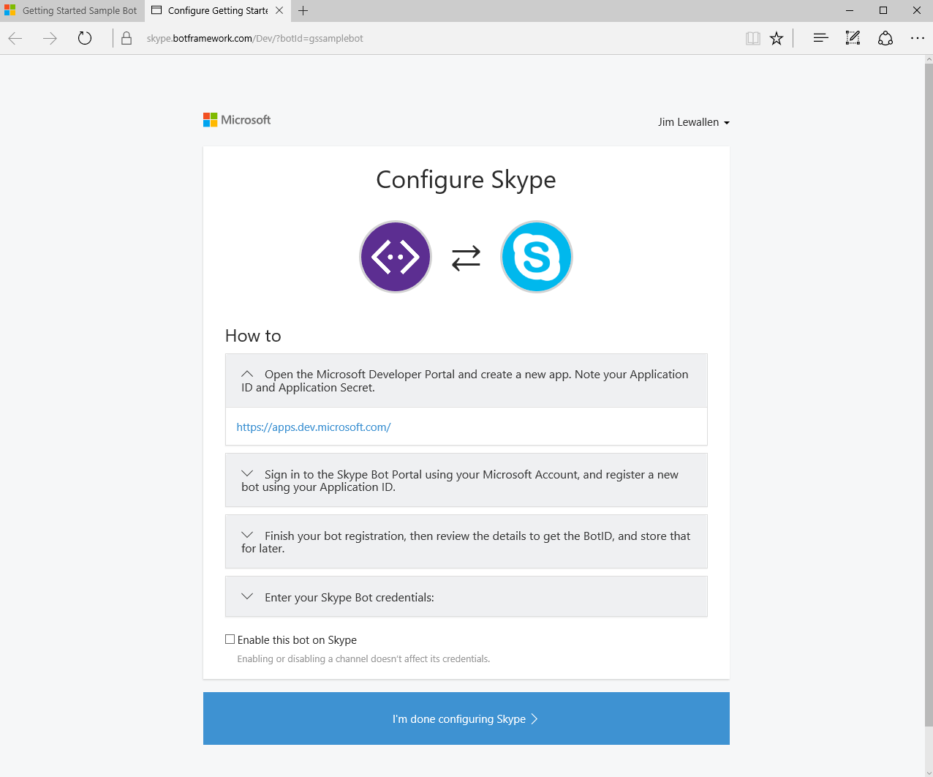
Microsoft Bot Framework
Configuring Channels

Slide 17
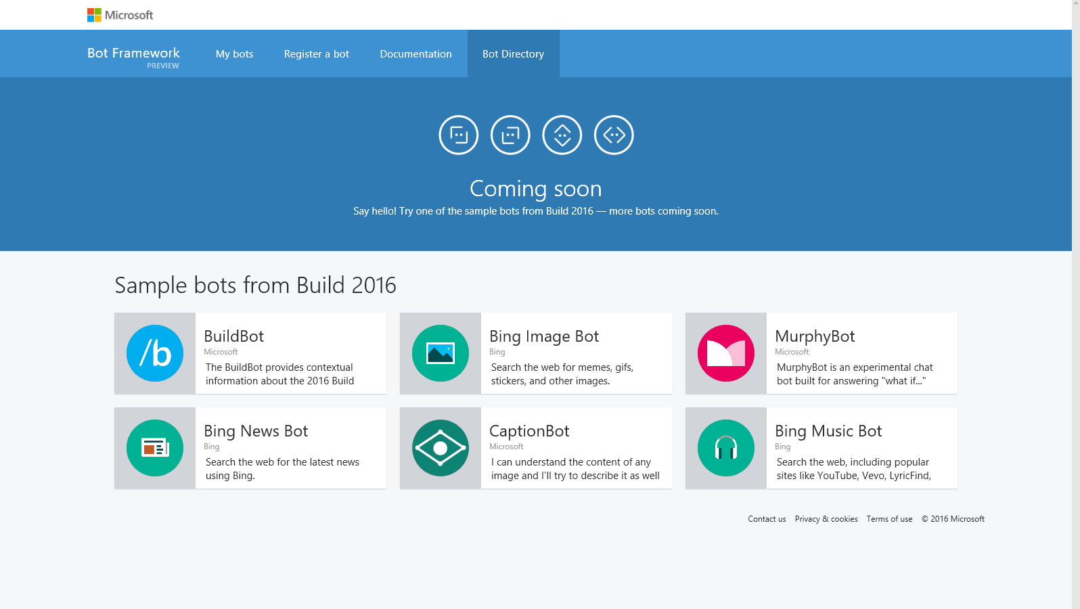
Microsoft Bot Framework
Directory (coming soon)

Slide 18
NER/NLP
http://msg.ai/
OpenCalais https://www.opencalais.com/opencalais-demo/
Dbpedia Spotlight
AlchemyAPI
BitextAPI https://www.bitext.com/text-analysis-api/
CogitoAPI http://www.cogitoapi.com/
Entitizer (Romanian, Russian, Bulgarian, Hungarian) http://klangoo.com/search.aspx
Magnet by Klangoo (40+ languages, including Klingon ...) http://klangoo.com/search.aspx
MeaningCloud http://www.meaningcloud.com/
Ingen.io https://www.quora.com/topic/Ingen-io
Rosette (many European, Middle Eastern and Asian langauges) https://developer.rosette.com/
Saplo https://www.quora.com/topic/Saplo-company
Semantria https://www.quora.com/topic/Semantria
Aylien.com http://aylien.com/
TextRazor https://www.textrazor.com/
Wolfram Alpha https://www.wolframalpha.com/
Microsoft Cognitive Services & Azure ML https://www.microsoft.com/cognitive-services/en-us/apis

Slide 19
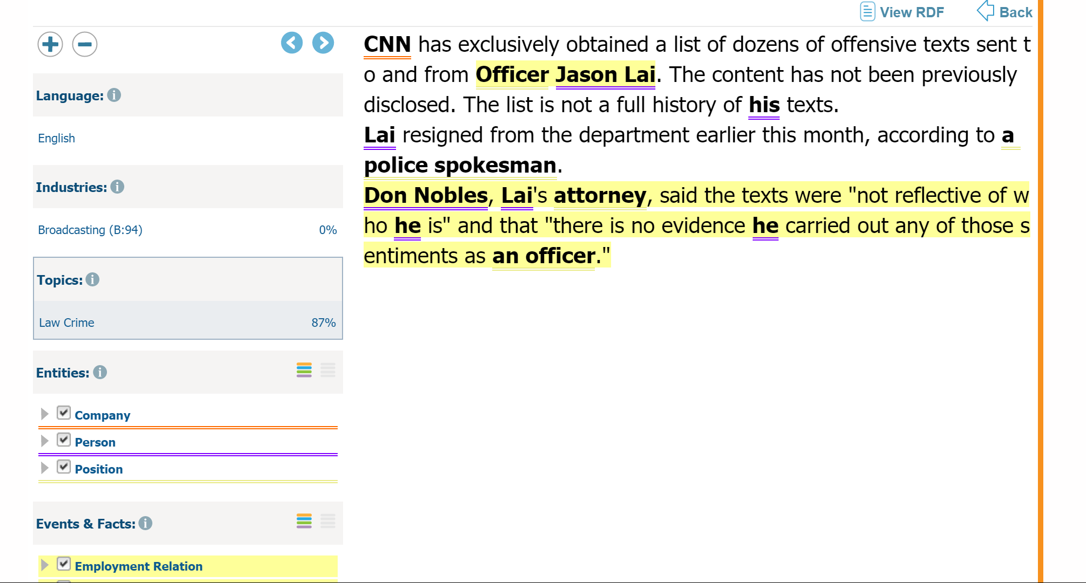
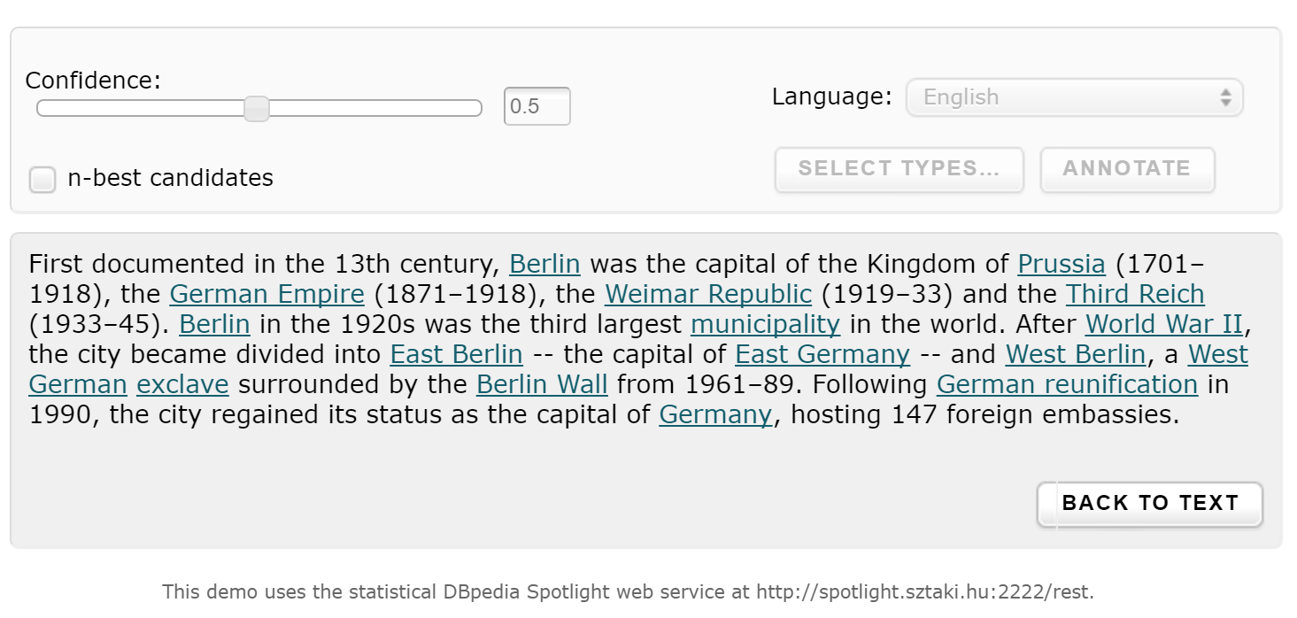
OpenCalais & Dbpedia

Slide 20
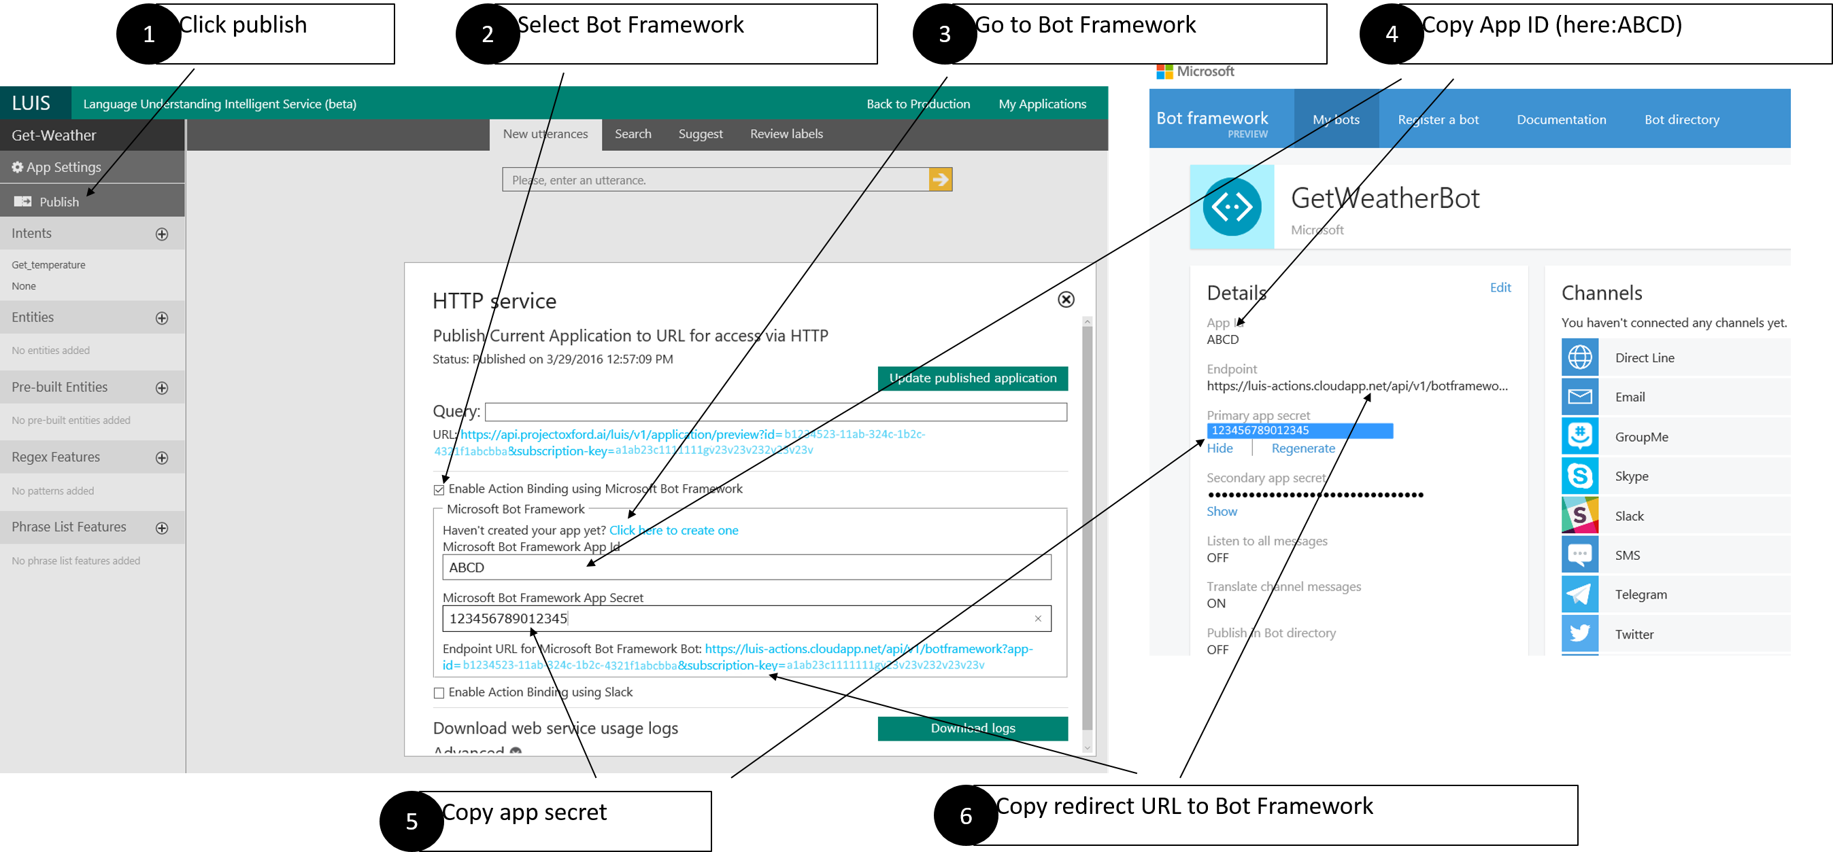
Luis
Language Understanding Intelligent Service (beta)
Language Understanding Intelligent Service (beta) https://www.luis.ai

Slide 21
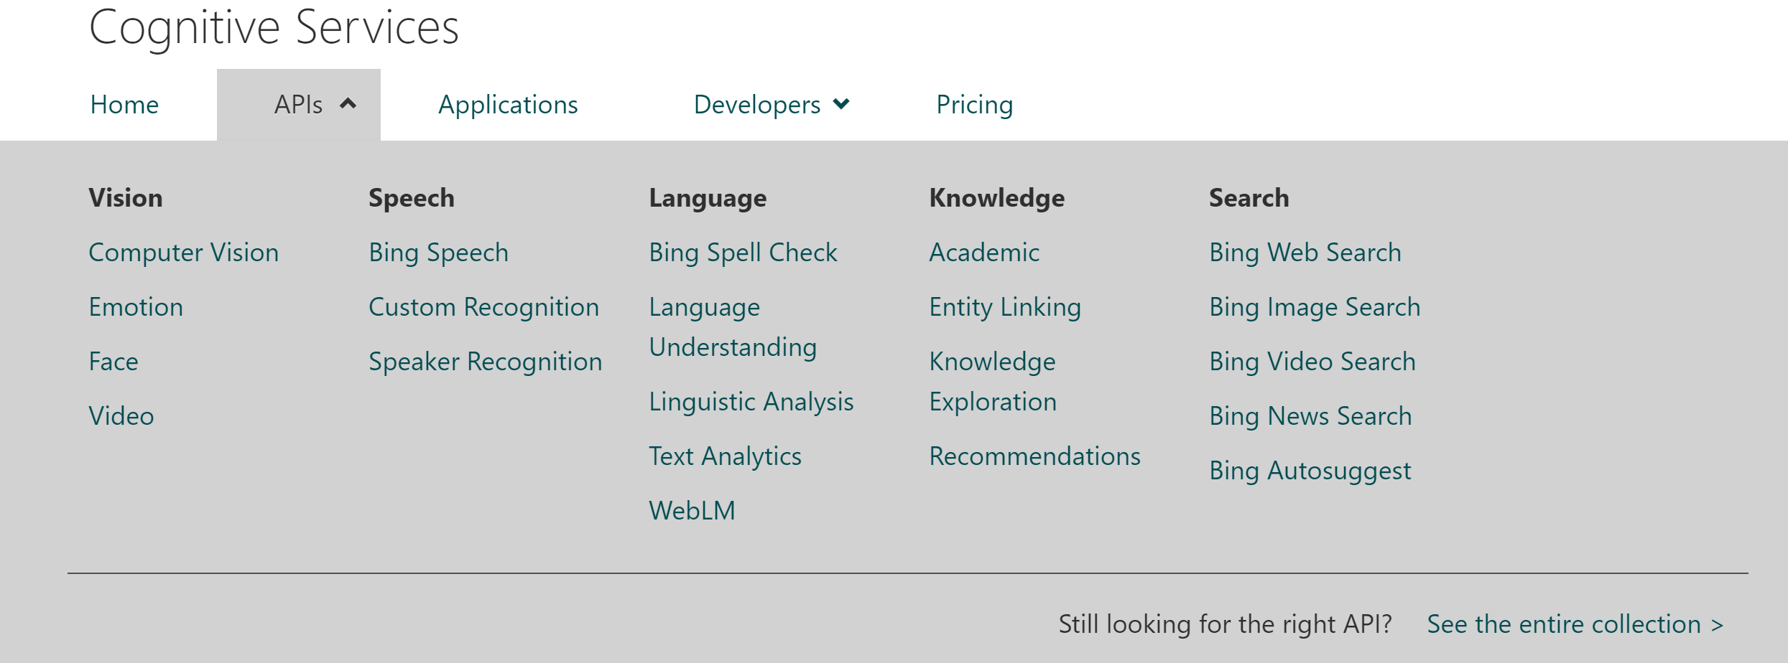
Microsoft Cognitive Services
Language Understanding Intelligent Service (beta)

Slide 22
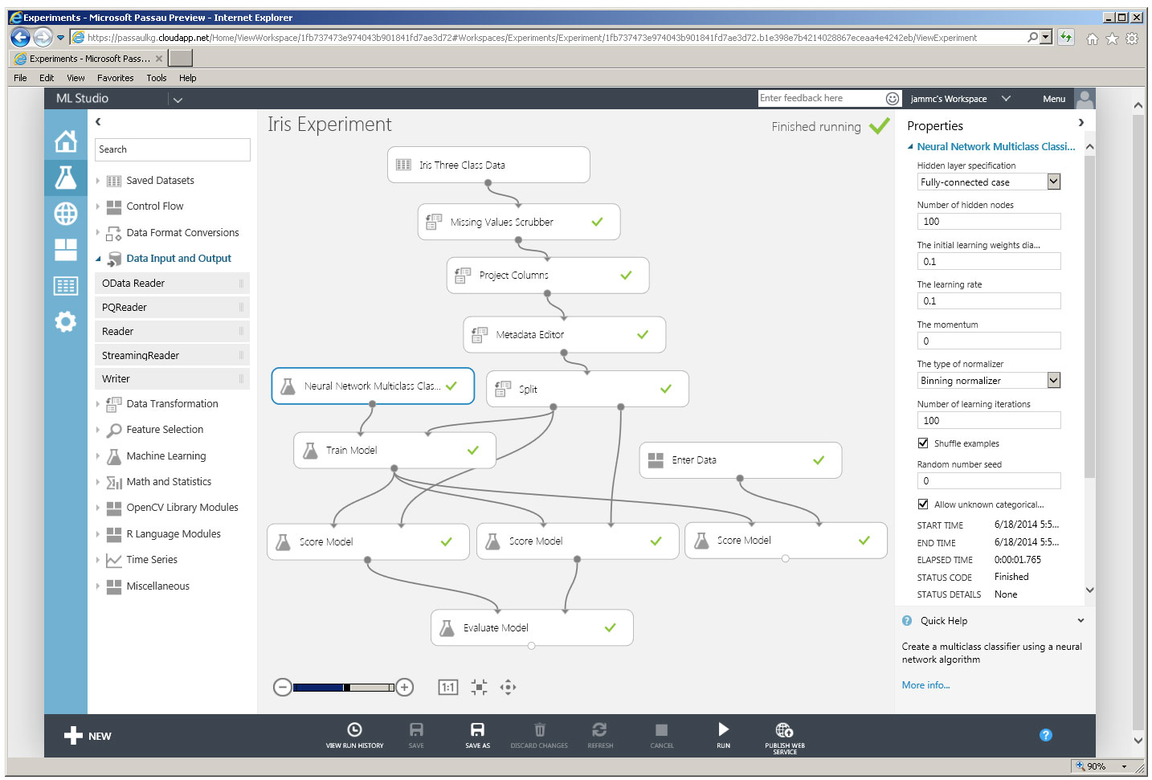
Azure Machine Learning (NER)
Language Understanding Intelligent Service (beta)
Microsoft Azure Machine Learning Studio is a collaborative, drag-and-drop tool you can use to build, test, and deploy predictive analytics solutions on your data.

Slide 23

Питання?
Олександр Краковецький
CEO, DevRain Solutions
Експерт Державного агентства з питань електронного урядування України при підтримці ПРООН
alex.krakovetskiy@devrain.com
https://www.facebook.com/alex.krakovetskiy
@msugvnua

